Slide 1



Movie Rating Prediction System Using Machine Learning
Soumya Karuturi-AP22110010175
Jyotika Tammineedi-AP22110010457
Shivani Mandava-AP22110010431
Pardhiv Chalapathi-AP22110011224
Guided by:
Dr. Murali Krishna Enduri

Slide 2

Problem Statement and Objectives
PROBLEM
OBJECTIVE
Traditional methods of evaluating a movie’s potential often rely on subjective opinions or limited data, there is a need for a data-driven approach that can accurately predict movie ratings based on objective features
To develop a predictive model using machine learning that estimates the ratings of movies by analyzing various attributes from the dataset.

Slide 3
Introduction To Movie Rating Prediction System
The Movie Rating Prediction System aims to leverage data-driven techniques to estimate the ratings of movies based on a variety of features such as movie name, year of release, duration, genre, IMDb rating, number of votes, director, and leading actors which are extracted from the dataset. It analyses historical data and patterns in these features, the project seeks to build predictive models that can accurately forecast a movie’s rating even before it receives audience feedback. Such a system can be valuable for filmmakers, producers, and audiences to gauge potential success and to make informed decisions.

Slide 4
System Workflow
1. Data Gathering
The dataset used is:IMDb Movies India.csv
This CSV file likely includes features such as movie titles, genres, directors, actors, release years, duration, and most importantly, ratings.
2. Data Preprocessing
Before feeding the data to a machine learning model, it must be cleaned and formatted properly.
Inspecting Data to understand the structure and quality of the data.
Handling the missing data to removes all rows that have missing (null) values.
Removing Duplicates and Re-checking Cleaned Data
3. Exploratory Data Analysis (EDA)
This is where we look at the patterns, trends, and correlations in the data.
EDA includes:
Visualizing distributions (histograms, count plots).
Understanding relationships between variables (heatmaps, pair plots).
Identifying outliers and trends.

Slide 5
4. Feature Selection
Relevant features are chosen or new ones are created to improve model accuracy.
Features like : Genre, Director, Cast, Duration, Language be encoded and used as inputs.
5. Model Building
A machine learning algorithm is trained to predict the rating of a movie. Possible algorithms include:
Linear Regression
Random Forest
More Models like Gradient Boosting, XGBoost, CatBoost, LightGBM, AdaBoost might be used for better accuracy.
6. Model Evaluation
The model is tested using metrics such as:
Mean Squared Error (MSE), Mean Absolute Error and R² Score for regression.
Predicts Accuracy.
Validation techniques like train-test split or cross-validation help estimate performance.
7. Prediction
Once the model is trained and evaluated, it is used to predict ratings for new movies or unseen data.

Slide 6
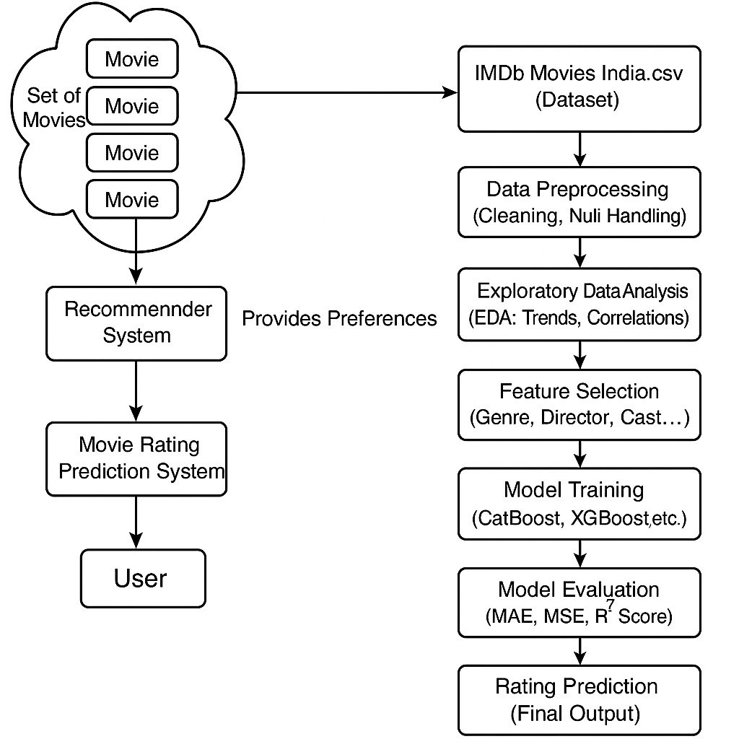
Methodology

Slide 7
Challenges and Limitations
Challenges
Limitations
Data Sparsity and Cold-Start: Limited historical data and sparse entries reduce prediction reliability
Overfitting and Model Generalization: Models like neural networks struggle with high-dimensional features, leading to overfitting and low R² scores (e.g., 0.42 for Random Forest).
Incomplete Metadata: Missing values and outliers (e.g., 10/10 ratings with only 5 votes) introduce noise.
Constraints of Model Performance: Algorithms like XGBoost achieve MAE of approximately 0.40, but 85% of ratings fall between 5–8, limiting error significance

Slide 8
Applications and Use Cases
Applications
Movie Recommendation Systems: It can be integrated into streaming platforms or movie websites.
Audience Engagement and Personalization: Platforms can personalize user experiences by highlighting movies likely to receive higher ratings to increase user engagement.
Content Acquisition and Curation: Streaming services and broadcasters can use predicted ratings to decide which movies to promote.
Use Cases
Pre-release Success Prediction
Automatic Content Filtering
Talent and Genre Analysis

Slide 9
Results
Achieved 93.74% accuracy using CAT Boost Model.
It is the best and efficient than any other models (better than Linear Regression, Random Forest, etc.)
Achieved Metrices: MSE = 0.26, MAE = 0.36, R² score = 0.86.
Feature engineering, such as calculating average ratings for genres, directors, and actors, helped improve prediction accuracy.
Genres and movie details also improved results.

Slide 10
Conclusion & Future Work
Conclusion
Future Work
The movie rating prediction system uses machine learning and feature engineering to accurately estimate ratings for movies, with the CatBoost model achieving MAE of about 0.36; this demonstrates how analyzing factors like genre, director, and actors can provide valuable insights and support smarter decisions for filmmakers and platforms.
Add deep learning models for better accuracy.
Incorporate additional features such as budget, box office collections, etc.
Address data sparsity and the cold-start problem for new movies or artists.
Develop a real-time, scalable system that can update predictions as new data becomes available

Slide 11


Thank You

